Slide 1

THE PERSUASIVE SPEECH
“Words create ripples, and ripples can come together to make waves.” –Michael Osborn
Notes:
*
1

Slide 2
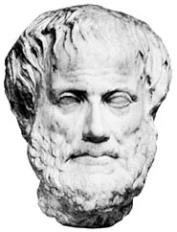
Aristotle
The goal of argumentative writing and speaking is to persuade your audience that your ideas are valid, or more valid than someone else's.
The Greek philosopher Aristotle divided the means of persuasion, appeals, into three categories--Ethos, Pathos, Logos.

Slide 3
A persuasive speech is a specific type of speech in which the speaker has a goal of convincing the audience to accept his or her point of view. The speech is arranged in such a way as to hopefully cause the audience to accept all or part of the expressed view.

Slide 4
The Definition of the Persuasive Speech
The art of gaining fair and favorable consideration for your point of view.
Notes:
*
4

Slide 5
Ethos, Pathos, Logos
Ethos (Credibility), or ethical appeal, means convincing by the character of the author.
We tend to believe people whom we respect.
One of the central problems of argumentation is to project an impression to the reader that you are someone worth listening to, in other words making yourself an authority on the subject of the paper, as well as someone who is likable and worthy of respect.
Use experts when you quote.

Slide 6
Pathos
Pathos (Emotional) means persuading by appealing to the reader's emotions. We can look at texts ranging from classic essays to contemporary advertisements to see how pathos, emotional appeals, are used to persuade.
Language choice affects the audience's emotional response, and emotional appeal can effectively be used to enhance an argument.

Slide 7

Persuasion does not work like this:
Listeners cheerfully accept whatever you pour into their heads.
7
Lect 8M

Slide 8
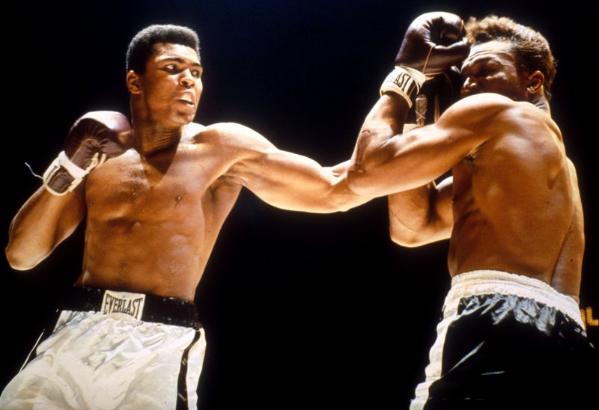
Persuasion does not work like this:
Beating your listeners into submission.
8
London Times

Slide 9
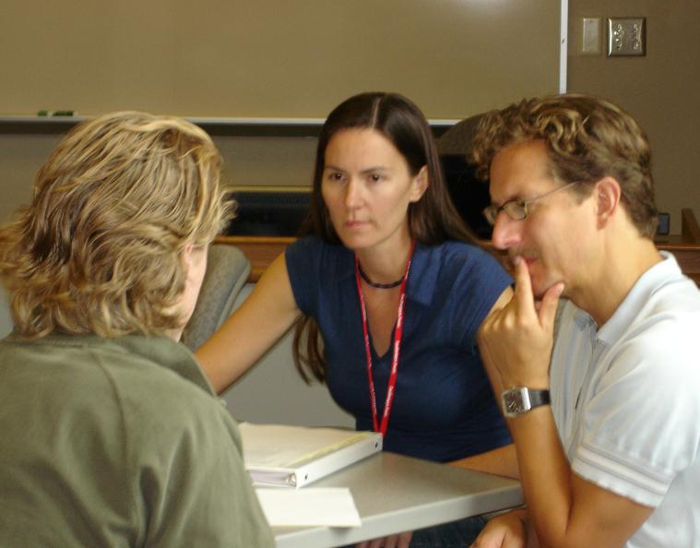
Persuasion works more like this:
Your listeners are your peers: they're going to think for themselves.
You can help them by answering their questions.

Slide 10
Eight Purposes of Persuasive Speeches:
1. To urge a choice among options.
2. Persuaders act as advocates for a cause or point of view.
3. To use supporting materials as evidence that justified advice.
4. Persuaded listeners become agents of change.
5. Asks for audience commitment to a cause
6. Establishes character and commitment of speaker through leadership
7. Makes appeals to feelings
8. Makes us confront our obligation to believe and act in socially and morally responsive ways.
Notes:
*
10

Slide 11
Harmful forms of persuasion:
Argumentative persuasion
Evil speakers can twist evidence and disguise bad reasoning
“The relation of the Jews to evil, even more, to the white-slave traffic, could be studied in Vienna…When thus for the first time I recognized the Jew as the cold-hearted, shameless, and calculating director of this revolting vice traffic in the scum of the big city, a cold shudder ran down my back.” –Adolph Hitler
Notes:
*
11

Slide 12
Harmful forms of persuasion:
Manipulative persuasion
Works by suggestion, colorful images, appealing music, and attractive spokespersons
Notes:
*
12

Slide 13



Slide 14
Types of Evidence to use in Persuasive Speeches:
Facts, figures, statistics
Use examples from “real life”
Narratives—make your audience witness to a living drama
Use Expert Testimony/Witnesses
When you quote others, you are associating yourself with them, so be careful whom you choose!
Reluctant witnesses are those who testify against their apparent self-interest and so are often more powerful (such as Democratic critics of a Democratic president).
Notes:
*
14

Slide 15
Evidence Example:
“I know a child—well, she must be 13 now—I’d better call her a young woman…She has memories. She has hopes. And she has juvenile diabetes.
Like so many kids with this disease, she has adjusted amazingly well. The insulin pump she wears—she’s decorated hers with rhinestones. She can insert her own catheter needle. She has learned to sleep through the blood drawings in the wee hours of the morning. She’s very brave. She is also quite bright and understands full well the progress of her disease and what it might ultimately mean: blindness, amputation, diabetic coma. Every day, she fights to have a future.
What excuse will we offer this young woman should we fail her now? What might we tell…the millions of others who suffer? That when given an opportunity to help, we turned away? That facing political opposition, we lost our nerve? That even though we knew better, we did nothing?”
-Ron Reagan at the 2004 Democratic Convention urging delegates to support embryonic stem cell research
Notes:
*
15

Slide 16
Evidence Example:
“It’s a cold, icy December afternoon. You hear a distant crash, then screams, and finally the unending moan of a car horn fills the silence. You rush the short distance to the scene of the crash, where you find an SUV overturned with a young woman and two small boys inside. The woman and one of the boys climb from the wreckage unhurt; the other boy, however, is pinned between the dashboard and the roof of the car, unconscious and not breathing.
Would you know what to do? Or would you stand there wishing you did? These events are real. Bob Flath saved this child with the skills he acquired at his company’s first aid workshop.”
-Kirsten Lientz, urging students to take a first aid course offered at her university
Notes:
*
16

Slide 17
Develop a Proof (an argument):
Aristotle believed there were three forms of proof:
Pathos: appeals to personal feelings such as fear, pity, and anger
Ethos: audiences respond to the speaker’s competence, character, goodwill, and dynamism and the credibility of the evidence
Logos: appeals to reason (logical arguments)
Scholars today believe that there is one final element to the proof:
Mythos: appeals to the traditions and values of your culture, legends, and folktales
Notes:
*
17

Slide 18
Logos: The heart of an argument
Reason from a principle that you believe everyone in your audience accepts (such as “Freedom of Speech”)
Reason from reality using statistics, comparisons, and even scientific data (Science is a good-term---a key word to give your data credibility)
Reason with parallel cases which are used to frame an unfamiliar concept in something more familiar
Notes:
*
18

Slide 19
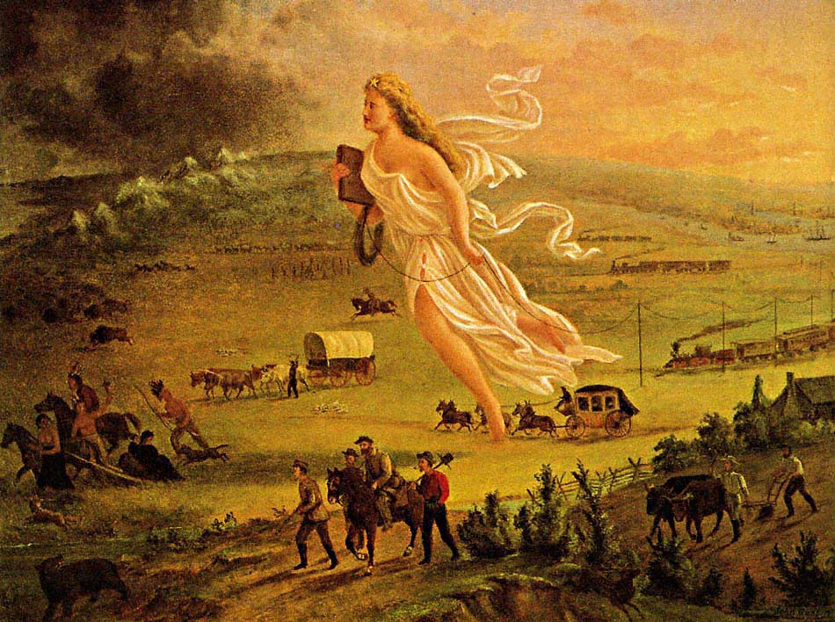
Which element is used in this painting?
American Progress by John Gast
Notes:
*
19

Slide 20
American Progress by John Gast
Excerpts from explanatory text that George A. Croffut provided to market John Gast's 1872 lithograph American Progress.
This rich and wonderful country--the progress of which at the present time, is the wonder of the old world--was until recently, inhabited exclusively by the lurking savage and wild beasts of prey. If the rapid progress of the "Great West" has surprised our people, what will those of other countries think of the "Far West," which was destined at an early day, to be the vast granary [grain producing region], as it is now the treasure chamber of our country?...
In the foreground, the central and principal figure, a beautiful and charming Female, is floating westward through the air bearing on her forehead the "Star of Empire...." On the right of the picture is a city, steamships, manufactories, schools and churches over which beams of light are streaming and filling the air--indicative of civilization. The general tone of the picture on the left declares darkness, waste and confusion. From the city proceed the three great continental lines of railway.... Next to these are the transportation wagons, overland stage, hunters, gold seekers, pony express, pioneer emigrant and the warrior dance of the "noble red man." Fleeing from "Progress"...are Indians, buffaloes, wild horses, bears, and other game, moving Westward, ever Westward, the Indians with their squaws, papooses, and "pony lodges," turn their despairing faces towards, as they flee the wondrous vision. The "Star" is too much for them.
...What home, from the miner's humble cabin to the stately marble mansion of the capitalist, should be without this Great National Picture, which illustrates in the most artistic manner all the gigantic results of American Brains and Hands! Who would not have such a beautiful token to remind them of the country's grandeur and enterprise which have caused the mighty wilderness to blossom like the rose!!!
Notes:
*
20

Slide 21
Which element is used in this example?
“There was a day when I walked into the halls of this Senate and worked closely with many of you and your staffs. There was a wonderful day when I was fortunate enough to serve the President of the United States in a capacity I had dreamed of all my life. And for a time, I felt that people looked up to me. Today, I can tell you how hard it is to have people speaking down to me. But nothing has been harder than losing the independence and control we all so value in life. I need help getting out of bed, help taking a shower, and help getting dressed.
There are some who oppose a simple seven-day waiting period for hand-gun purchases because it would inconvenience gun buyers. Well, I guess I am paying for their convenience. And I am one of the lucky ones. I survived being shot through the head. Other shooting victims are not as fortunate.”
-James Brady, Presidential Press Secretary who was shot during the assassination attempt on President Reagan
Notes:
*
21

Slide 22
Which element is used in this example?
“The American flag stands for more than our power and our interests. Our founders dedicated this country to the cause of human dignity, the rights of every person and the possibilities of every life. This conviction leads us into the world to help the afflicted, and defend the peace, and confound the designs of evil men.”
President George W. Bush, State of the Union address 2003

Slide 23
Which element is used in this example?
“I want you to imagine with me a computer game called “Puppy Shoot.” In this game puppies run across the screen. Using a joystick, the game player aims a gun that shoots the puppies. The player is awarded one point for a flesh wound, three points for a body shot, and ten points for a head shot. Blood spurts out each time a puppy is hit—and brain tissue splatters all over whenever there’s a head shot. The dead puppies pile up at the bottom of the screen. When the shooter gets to 1,000 points, he gets to exchange his pistol for an Uzi, and the point values go up.
If a game as disgusting as that were to be developed, every animal rights group in the country, along with a lot of other organizations, would protest, and there would be all sorts of attempts made to get the game taken off the market. Yet, if you just change puppies to people in the game I described, there are dozens of them already on the market—sold under such names as “Blood Bath,” “Psycho Toxic,” “Redneck Rampage,” and “Soldier of Fortune.”
-Dr. Richard Corlin, President of the American Medical Association, 2001. “The Secrets of Gun Violence in America.”

Slide 24
Constructing an Argument
Create an Awareness of the problem/issue
First, make sure that the audience knows that the issue exists
Make a case for the problem/issue is an important one that needs to be fixed/addressed

Slide 25
Constructing an Argument
Create an understanding of the issue/problem
Use data and statistics to illustrate the problem/issue
Use testimony, stories, examples to connect with your audience (Logos, Pathos, Ethos, Mythos)
You can also respectfully address the “other side” of the issue/problem

Slide 26
Constructing an Argument
Offer a solution/plan/action that would address the issue or solve the problem:
If you have offered a valid argument, the audience may accept your position and be ready to act.
Have a valid plan that is logical
Notes:
*
26

Slide 27
Constructing an Argument
Enactment:
Get them to act on what you say or the argument you presented
Have them sign a petition, raise their hands, voice agreement, write letters to politicians, etc.

Slide 28
Very Controversial Topics/ Difficult audiences:
Set modest goals (you may not change anyone’s mind), such as asking only for a fair hearing from the audience.
Give a multi-sided presentation
Acknowledge the arguments on the other side
Show respect at all times for the opposition
Notes:
*
28

Slide 29
Example of Multi-Sided:
“I know that many of you may not like to hear what I’m saying, but think about it. If capital punishment does not deter violent crime, if indeed it may encourage more violent crime, isn’t it time we put capital punishment itself on trial?
I know that the desire for revenge can be strong. If someone I love had been murdered, I would want the killer’s life in return. I wouldn’t care if capital punishment wasn’t fair. I wouldn’t care that it condones brutality. I would just want an eye for an eye. But that doesn’t mean you should give it to me. It doesn’t mean that society should base its policy on my anger and hatred.”
Notes:
*
29

Slide 30
B a s i c s i n a B o x
GUIDELINES & STANDARDS
Persuasive Speech
Content
A successful persuasive speech should
open with a clear statement of the issue and your opinion
be geared to the audience you’re trying to persuade
provide facts, examples, statistics, and reasons to support your opinion
answer opposing views
show clear reasoning
include strategies such as frequent summaries to help listeners remember your message
end with a strong restatement of your opinion or a call to action
Delivery
A successful presenter should
convey enthusiasm and confidence
stand with good, but relaxed, posture and make eye contact with the audience
include gestures and body language to enhance the presentation
incorporate visual aids effectively

Slide 31
Writing and Delivering Your Persuasive Speech
Planning and Drafting
1
To find topic ideas for your speech:
Make a list of things you feel strongly about.
Brainstorm with friends about issues that you often debate.
After you find a topic that you’d like to develop into a speech, follow these steps.

Slide 32
Steps for Planning and Drafting Your Speech
1. Clarify your position. How do you feel about the issue and why?
2. Find support for your position. What research will you have to do to back up your case? Where can you find that information? Which evidence will help you make your point most effectively?
3. Identify your audience. What do your listeners already know about the issue? What is their stand on it?

Slide 33
Steps for Planning and Drafting Your Speech
4. Consider how to grab your listeners’ attention. What startling statistics, amusing anecdotes, or intriguing questions can you use to hook your audience at the beginning?
5. Decide how to present your arguments? How can you organize your arguments so they have the greatest impact? Do you want to begin with the argument your audience will probably agree with and move to more controversial points? Would starting with the strongest argument—or ending with it—work better?

Slide 34
Writing and Delivering Your Persuasive Speech
Planning and Drafting
1
Think about how you will present your speech. What verbal and nonverbal techniques will work best to capture and maintain your audience’s interest and attention?

Slide 35
Writing and Delivering Your Persuasive Speech
Practicing and Delivering
2
The best way to practice your speech is to present it aloud—again and again.
Try speaking in front of a mirror so you can evaluate and improve your posture, gestures, eye contact, and use of visual aids.
You might tape-record a practice session so you can critique your voice quality and effectiveness.

Slide 36
Steps for Delivering Your Speech
1. Use your voice effectively. Speak loudly enough to be heard, but vary your pitch and tone.
2. Maintain eye contact. Look directly at a member of the audience while you speak, moving your eyes from person to person.

Slide 37
Steps for Delivering Your Speech
3. Incorporate gestures and facial expressions. Let your emotions show in your face—particularly in your eyes and mouth.
4. Use visual aids. Organize your information into charts, graphs, or drawings that will reinforce your message. Make sure your materials are large enough and clear enough that everyone in the audience can read them.

Slide 38
Writing and Delivering Your Persuasive Speech
Revising
3
TARGET SKILL
RESPONDING TO AUDIENCE FEEDBACK
A persuasive speech is successful only if it convinces your audience. Here are some comments peer reviewers might make and ways you can respond.

Slide 39
Writing and Delivering Your Persuasive Speech
Revising
3
TARGET SKILL
RESPONDING TO AUDIENCE FEEDBACK
I couldn’t remember the points you made.
Include frequent summaries and reminders such as “I’ve just shown that you should believe X for reason A. My second reason for believing X is . . . .”

Slide 40
Writing and Delivering Your Persuasive Speech
Revising
3
TARGET SKILL
RESPONDING TO AUDIENCE FEEDBACK
I couldn’t hear you.
Speak loudly, but don’t shout. Be sure to vary your volume and tone. Try to speak clearly and not too quickly.

Slide 41
Writing and Delivering Your Persuasive Speech
Revising
3
TARGET SKILL
RESPONDING TO AUDIENCE FEEDBACK
Your evidence didn’t convince me.
Gather additional expert opinions, facts, statistics, and examples; reorganize your arguments; check your reasoning.

Slide 42
Writing and Delivering Your Persuasive Speech
Revising
3
TARGET SKILL
RESPONDING TO AUDIENCE FEEDBACK
I was bored.
Include an interesting quotation or personal anecdote; change the pace and volume of your voice; move around the room.

Slide 43
Hasty Generalization
"A hasty generalization is a broad claim based on too-limited evidence. It is unethical to assert a broad claim when you have only anecdotal or isolated evidence or instances.
Hasty generalizations arise when we illegitimately generalize from a nonrepresentative sample. They are the source of many stereotypes.
Consider two examples of hasty generalizations based on inadequate data:-

Slide 44
1) You can't speak French. I can't speak French. Muharrir can't speak French. I must therefore conclude that nobody at the NSUcan speak French." "Really," said Polly, amazed. "Nobody?“
An environmental group illegally blocked loggers and workers at a nuclear plant. Therefore, environmentalists are radicals who take the law into their own hands.

Slide 45
1) I've met three children from this school and they were all naughty, so all children from this schooll are naughty.
2) Everyone who responded to the survey said the exercise program helped them lose weight. Therefore, everyone who used the program lost weight.

Slide 46
What is a false cause fallacy?
The questionable cause—also known as causal fallacy, false cause, or non causa pro causa ("non-cause for cause" in Latin)—is a category of informal fallacies in which a cause is incorrectly identified.
A false cause fallacy occurs when one cites to sequential events as evidence that the first caused the second.
Example: Every day, I eat “ ruti and alu bhaji for breakfast. One time, I had a khichuri instead, and there was a major earthquake in my city. I've eaten ruti and alu bhaji ever since.

Slide 47
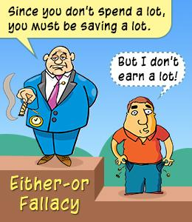
Either /or fallacy
The either-or fallacy is
when someone provides
a number of choices when
there is actually more
than that number.

Slide 48
To explain it in simple terms, the either-or fallacy refers to presenting two opposing options in a situation, in such a way that they seem to be the only available options.
"There are some things money can't buy. For everything else, there's MasterCard."

Slide 49
Straw Man A fallacy
Straw Man A fallacy is an argument or belief based on erroneous reasoning.
Straw man is one type of logical fallacy.
Straw man occurs when someone argues that a person holds a view that is actually not what the other person believes. Instead, it is a distorted version of what the person believes. So, instead of attacking the person's actual statement or belief, it is the distorted version that is attacked.

Slide 50
Student tells his professor that he thinks some of Hillary Clinton's positions have merit. Professor says he can't believe that the student supports giving access to classified documents to foreign countries.

Slide 51
Ad Hominem
An ad hominem argument is one that is used to counter another argument;
but, it is based on feelings or prejudice, rather than facts, reason or logic.

Slide 52
It is often a personal attack on one’s character rather than an attempt to address the issue at hand.
This type of fallacy can often be witnessed in usage in individual debate, in court or in politics. Often, the attack is based on one’s social, political, or religious views, or is based on lifestyle choices of the person being attacked using ad hominem.

Slide 53
A lawyer attacking a defendant’s character rather than addressing or questioning based on the case, e.g., in a case of theft pointing out the defendant’s level of poverty.

Slide 54
Hasty generalization
Hasty generalization is an informal fallacy of faulty generalization by reaching an inductive generalization based on insufficient evidence—essentially making a rushed conclusion without considering all of the variables.

Slide 57
False Cause
It is important to understand that there really might be a causal connection between these events, but we cannot infer there is one merely because one event chronologically preceded another.

